Slide 2
ICT in ESL classrooms
2018
Dagmar Škorpíková
dagmar@skorpikova.cz

Slide 3
You and ICT I
Work alone.
Walk around the room and complete the statements with frequency adverbs.
Work in pairs / groups of 3 and share your views.

Slide 4
You and ICT II
Discuss in your groups / pairs:
Is it good to use ICT in language teaching?
Why are many teachers still afraid of using ICT?
Is internet security at school an issue?

Slide 5
Effective ICT use in ESL
Getting closer to Ss and their interests
Not on surface, but intertwined
Higher engagement (motivation)
Mobility
Promotes independence
Access to the target culture
Time saver for teachers

Slide 6
ESL areas and ICT
Real materials (reading, listening)
Fun (games, songs, TV shows)
Stories creation
Photos
Video (trailers, commercials, dubbing…)
Others?

Slide 7
Offer of topics
Select up to 3 topics in the FB survey.

Slide 8
Offer of Topics
Cloud (GD) - sharing online; quizzes
Project sites (Voki, Padlet, eTwinning, GD)
Dictionaries online (Farlex, Eng.Profile)
Prezi (presentations)
Kahoot; Quizlet (online quizzes)
Easy Class (managing groups and classes)
Online language games (Livemocha / Langevo)

Slide 9
PADLET app
www.padlet.com
Our link:

Slide 10
Sharing
Reading
Listening
Videos
Songs
Textbooks
Grammar
Vocabulary

Slide 11
COMPETITION :-D
Searching online
Work alone. Find as quickly as possible:
a video on the topic of ICT-use in classes
a presentation on the topic of ICT in lessons
a drawing on the same topic
an academic publication on the same topic

Slide 12
Sharing online
How do you share materials with your students online?
Groups / e-classes
Easy Class
Facebook
PB Works
Moodle
Twitter
Shared space
Google Drive
Dropbox
Youtube
uschovna.cz
Cloud servers

Slide 13
Textbooks online
Work alone. Go online and look for available official online materials that supplement the textbook you use, e.g. IWB software, games, exercises, tests.
Have you found enough of them?
Are they useful?
Is there a variety of them?
Share using PADLET.

Slide 14
ICT and language teaching
What are your favourite pages / online resources / tools / apps for teaching the four basic language skills, i.e. reading, listening, speaking, and writing?
Which online tools do you use for teaching vocabulary and grammar?
Share links using Padlet

Slide 15
Clever tools and more
Applications
Language games (Livemocha, Langevo)
E-dictionaries (Farlex, Cambridge, Profile)
Online exercises
Online tests
Videos
Pictures
?

Slide 16
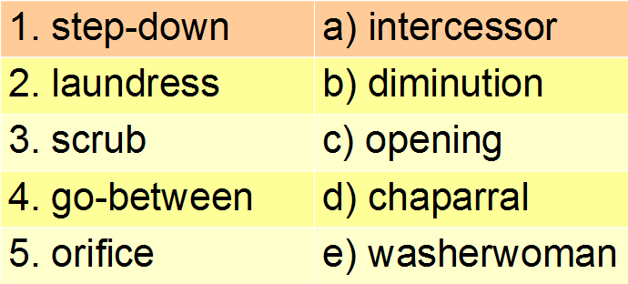
Dictionaries
SW: Match up (Farlex)
Match each word in the left column with its synonym in the right one.
KEY:1b, 2e, 3d, 4a, 5c

Slide 17
List – ESL lab:
http://www.esl-lab.com/
Gr – Agenda Web:
http://www.agendaweb.org
Tools for educators:
http://www.toolsforeducators.com/
Sp - Voki: www.voki.com
http://www.fotobabble.com
Wr - Blog:
www.blog.cz
Voc – Wordle:
http://www.wordle.net/
Voc – pronunciation:
www.manythings.org/pp
http://vocaroo.com/

Slide 18
Online quiz / survey
Do you use them with your students?
Why (not)? When / For which purpose?
Work alone. Go to Google Drive and prepare a quiz to use with your students the next lesson.
Share the link with us on Padlet.

Slide 19
Smartphones in ESL
Discuss in pairs/groups:
How do you / could you effectively use mobile phones in English lessons?
Share your ideas on Padlet

Slide 20
(E-book) readers in class
Ss are very involved:
brainstorming
drafting
revising
editing
publishing
embedding video, etc.
Kindle
Bridge
ePub Bud

Slide 21
Online project platforms
International context:
eTwinning
Regional context:
Facebook
Google
Wiggio
Twiddla
Padlet
GlogsterEDU

Slide 22
IWB
Watch the video and note down the IWB techniques mentioned in it.
Discuss in pairs / groups:
… the pros and cond of IWB use in class

Slide 23
Over to you :-)
ICT in a language classroom should …
support the textbook material
be interesting for students
have a clear purpose

Slide 24
Reflection – I can ...
use multimedia and work with them in ESL
effectively employ IWB materials
create an online group / class and manage it
find and use online textbook components
find and use materials to enhance lang. skills
make use of smartphones and e-book readers
use e-tools, apps and programmes in ESL
use online media for project work

